Slide 1
Hands On Machine Learning
Chapter 04. Model Training
장준영
jjy1019@inha.edu
2024.09.19

Slide 2
INDEX
4.0 Preview
4.1 Linear Regression
4.2 Gradient Descent
4.2.1 Batch Gradient Descent
4.2.1 Stochastic Gradient Descent
4.2.1 Mini-Batch Gradient Descent
4.3 Polynomial Regression
4.3.1 PolynomialFeatures

Slide 3
4.0 Preview
Model Training
Linear Regression
Gradient Descent
Polynomial Regression
Overfitting, Underfitting
Lidge, Rasso
Logistic Regression, Softmax Regression

Slide 4
4.0 Preview
Basic
Vector, Matrix
Transpose
Dot product
Inverse matrix
Partial derivative

Slide 5
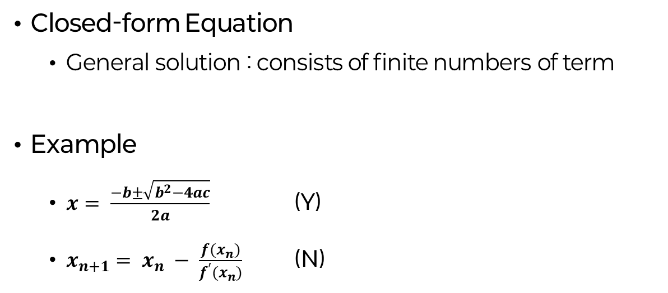
4.0 Preview
Closed-form Equation
General solution : consists of finite numbers of term
Example
$x= \frac{−b±\sqrt{b^{2}−4ac}}{2a}$ (Y)
$x_{n+1}= x_{n} − \frac{f(x_{n})}{f^{′}(x_{n})}$ (N)

Slide 6
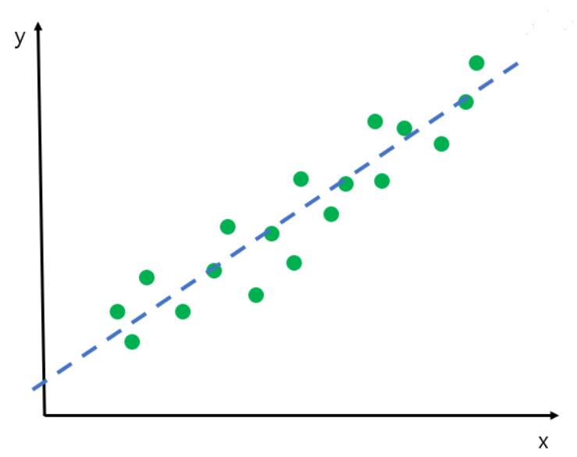
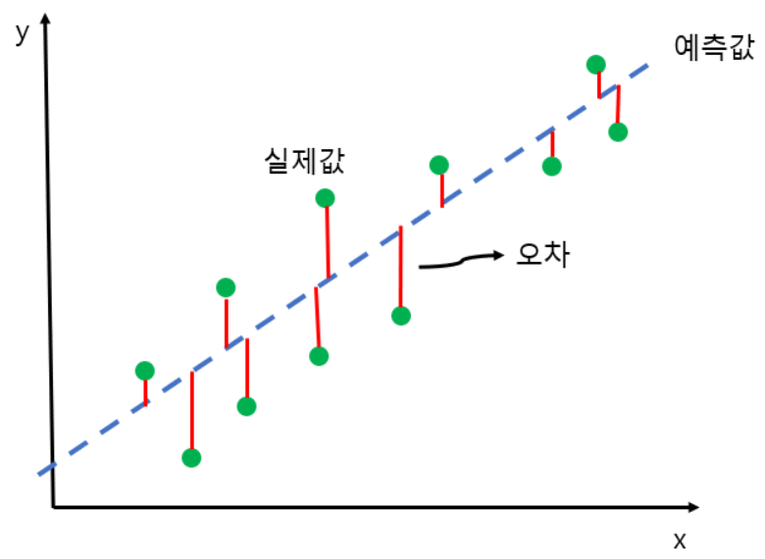
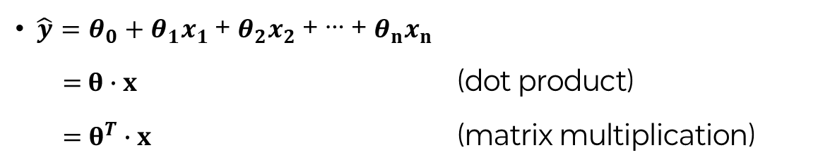
4.1 Linear Regression
$\hat{y}=θ_{0}+θ_{1}x_{1}$ + $θ_{2}x_{2}$ + … + $θ_{n}x_{n}$
$=$ $θ∙x$ (dot product)
$=$ $θ^{T}∙x$ (matrix multiplication)

Slide 7
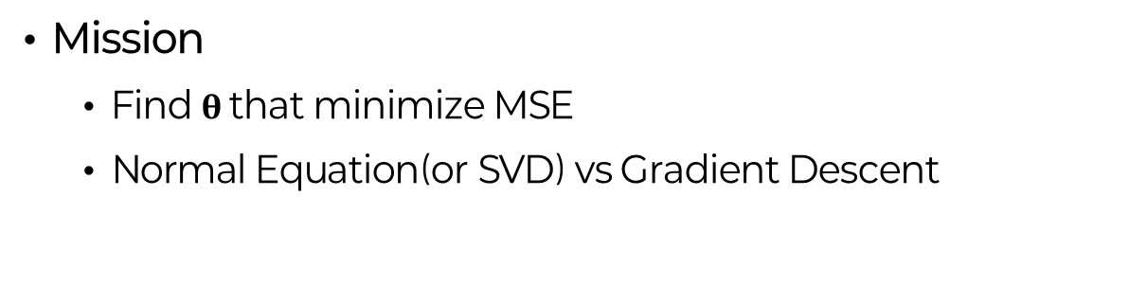
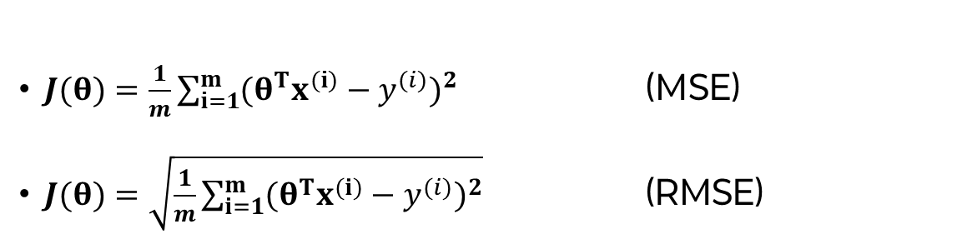
4.1 Linear Regression : MSE
$J(θ)=\frac{1}{m}\sum_{i=1}^{m}{{(θ^{T}x^{(i)}−y^{(i)})}^{2}}$ (MSE)
$J(θ)=\sqrt{\frac{1}{m}\sum_{i=1}^{m}{{(θ^{T}x^{(i)}−y^{(i)})}^{2}}}$ (RMSE)
Mission
Find $θ$ that minimize MSE
Normal Equation(or SVD) vs Gradient Descent

Slide 8
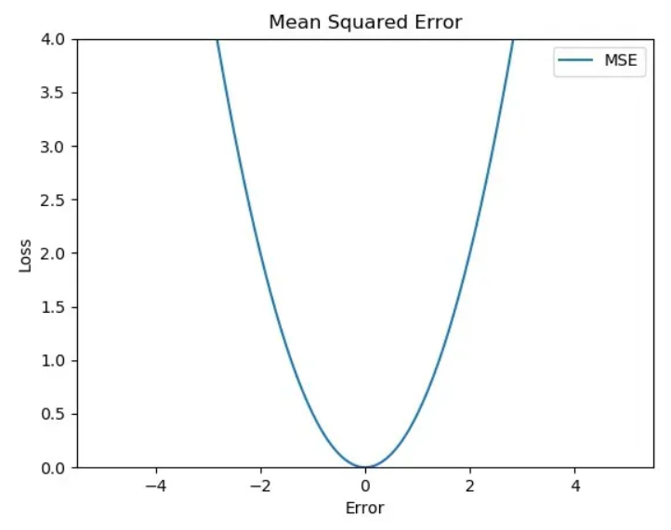
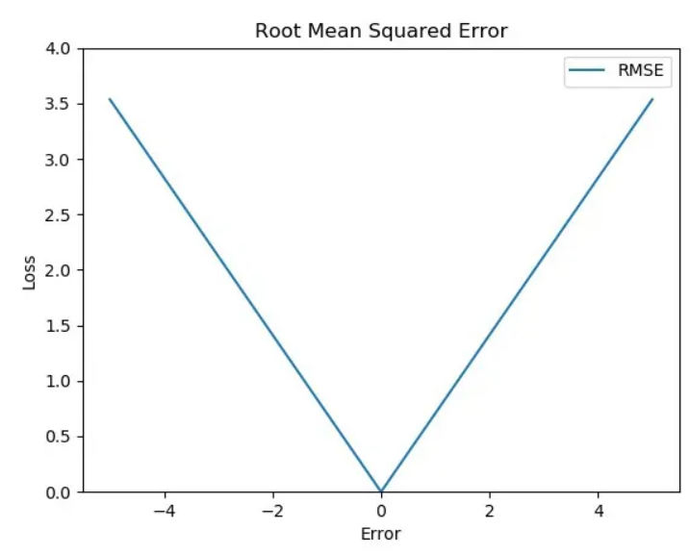
4.1 Linear Regression : MSE vs RMSE
MSE | RMSE
Sensitive to outlier | Less sensitive to outlier
Differentiable | Existence of non-differentiable points

Slide 9
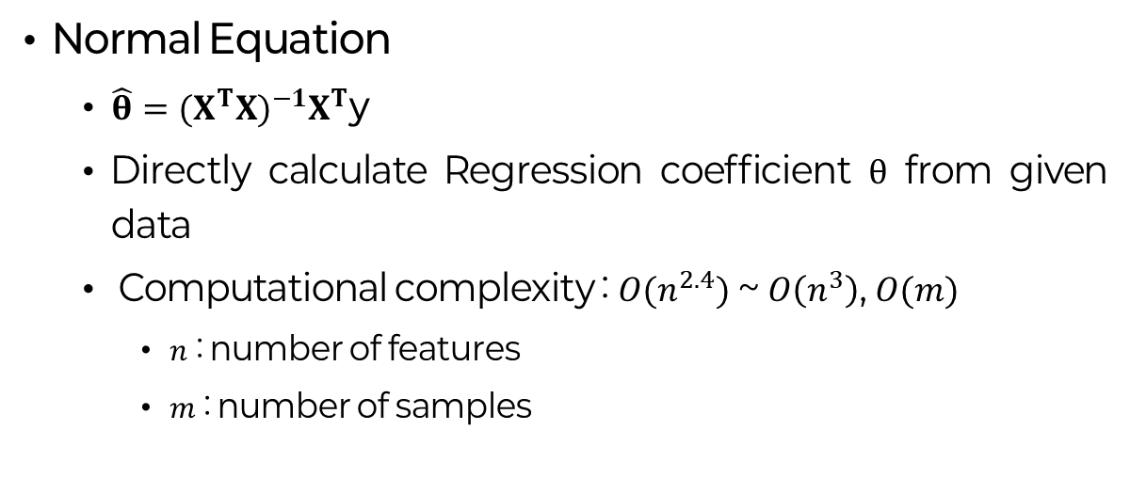
4.1 Linear Regression : Normal Equation
Normal Equation
$\hat{θ}={(X^{T}X)}^{−1}X^{T}$y
Directly calculate Regression coefficient $θ$ from given data
Computational complexity : $O(n^{2.4})$ ~ $O\left(n^{3}\right)$, $O(m)$
$n$ : number of features
$m$ : number of samples

Slide 10
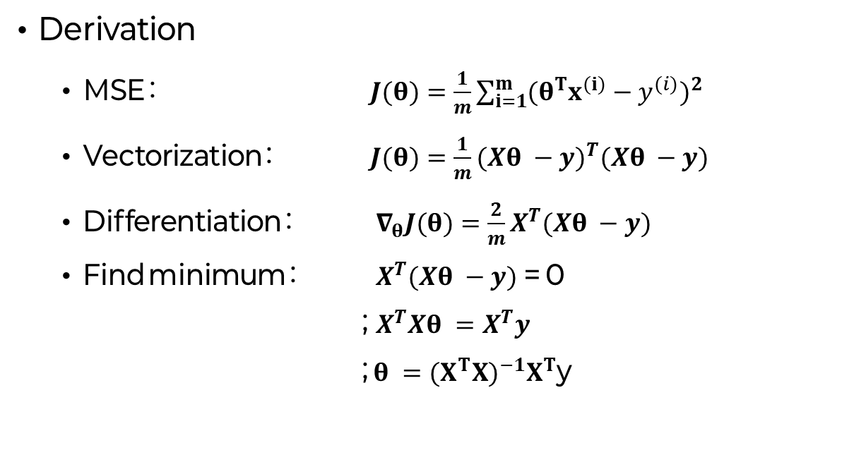
4.1 Linear Regression : Normal Equation
Derivation
MSE : $J(θ)=\frac{1}{m}\sum_{i=1}^{m}{{(θ^{T}x^{(i)}−y^{(i)})}^{2}}$
Vectorization : $J(θ)=\frac{1}{m}{(Xθ −y)}^{T}(Xθ −y)$
Differentiation : $∇_{θ}J(θ)=\frac{2}{m}X^{T}(Xθ −y)$
Find minimum : $X^{T}(Xθ −y)$ = 0
; $X^{T}Xθ =X^{T}y$
; $θ ={(X^{T}X)}^{−1}X^{T}$y

Slide 11
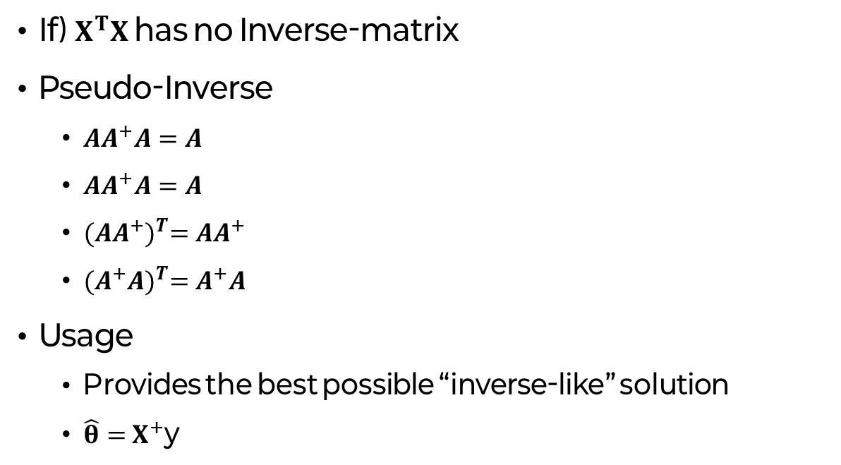
4.1 Linear Regression : Pseudo-Inverse
If) $X^{T}X$ has no Inverse-matrix
Pseudo-Inverse
$AA^{+}A=A$
$AA^{+}A=A$
${(AA^{+})}^{T}=AA^{+}$
${(A^{+}A)}^{T}=A^{+}A$
Usage
Provides the best possible “inverse-like” solution
$\hat{θ}=$ $X^{+}$y

Slide 12
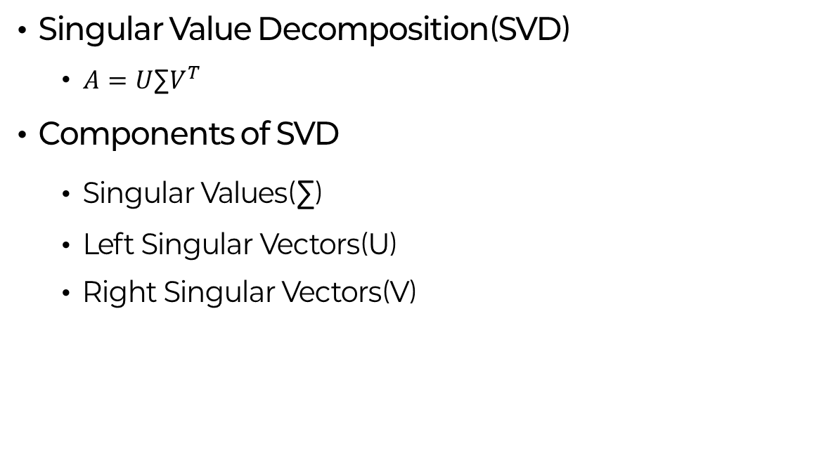
4.1 Linear Regression : SVD
Singular Value Decomposition(SVD)
$A=U\text{∑}V^{T}$
Components of SVD
Singular Values(∑)
Left Singular Vectors(U)
Right Singular Vectors(V)

Slide 13
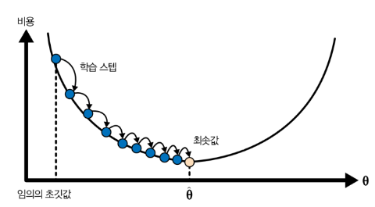
4.2 Gradient Descent
Gradient Descent
“The best way to get down the valley quickly, is to take the steepest path”
Calculate the current loss function’s gradient
Set parameters in the direction of decreasing gradient

Slide 14
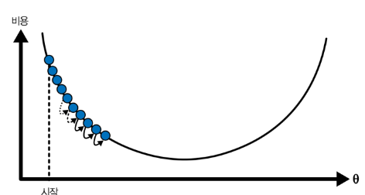
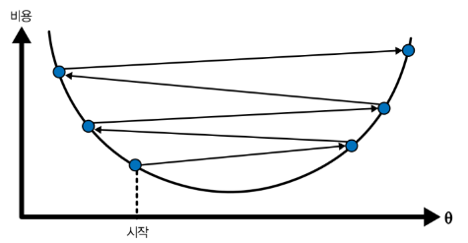
4.2 Gradient Descent
Learning rate
Determine the size of the weight(parameter) update
Too Low | Too High
Learning time is taking too long | Not converging

Slide 15
4.2 Gradient Descent
StandardScaler
Feature Scaling
Fit all features to the same range
If feature scaling is not done properly
1) certain features may have too much influence
2) learning may proceed very slowly
StandardScaler : Standardization

Slide 16
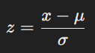
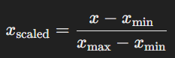
4.2 Scaling : Standardization vs Normalization
Standardization | Normalization
Transform data into a normal distribution(mean=0, SD=1) | Convert data between 0 and 1
Linear regression, logistic regression, SVM, neural networks, etc. | KNN, K-means clustering, neural networks, etc.

Slide 17
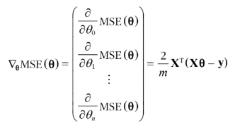
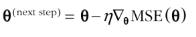
4.2.1 Batch Gradient Descent
Batch Gradient Descent
Compute gradients over the entire training set at each GD step.

Slide 18
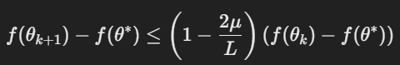
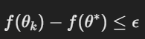
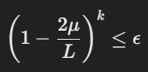
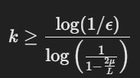
4.2.1 caution : Rate of Convergence
Rate of Convergence
Converging speed to find a solution
O(1/e) (e : error range)
Pf)
O(1/e)
(doesn’t guarantee geometric convergence)

Slide 19
4.2.2 Stochastic Gradient Descent
Stochastic Gradient Descent
Randomly select one sample at each step
Compute the gradient for that one sample
Advantages
Faster than BGD
Very large training sets can be available
Disadvantages
Unstable(but helps to skip local minimum)

Slide 20
4.2.2 Learning Schedule
Learning Schedule
Decrease learning rate gradually
Determine learning rate each step
LR decreases too quickly
Stuck in local minimum
Stop midway to the global minimum
LR decrease too slowly
Stuck in local minimum
Hovering around the global minimum for a long time

Slide 21
4.2.3 Mini-batch Gradient Descent
Mini-batch Gradient Descent
Mini batch : A random small sample set
Select mini-batch and calculate gradient of it
Advantages
Improved performance
Moves less erratically than SGD
Disadvantages
May be more difficult to escape from a local minimum

Slide 22
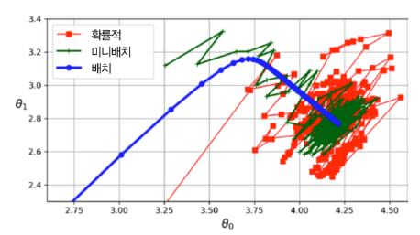
4.2.3 Mini-batch Gradient Descent

Slide 23
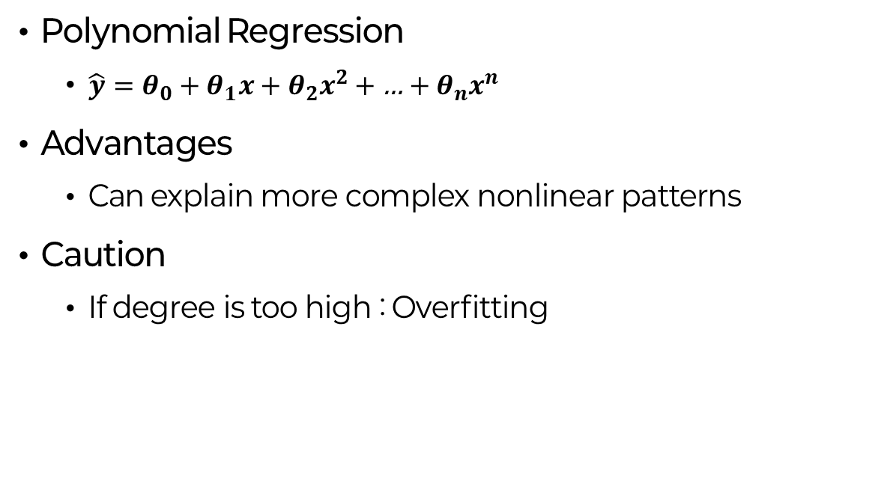
4.3 Polynomial Regression
Polynomial Regression
$\hat{y}=θ_{0}+θ_{1}x$ + $θ_{2}x^{2}$ + … + $θ_{n}x^{n}$
Advantages
Can explain more complex nonlinear patterns
Caution
If degree is too high : Overfitting

Slide 24
4.3 caution : PolynomialFeatures
PolynomialFeatures
Converts the given input data into polynomial forms
Parameters & Options
Degree
Interaction_only
Include_bias

